Slide 1
Booking Express Subject: Software Project
Submitted to: JMP Sir
Date: 12/04/2019

Slide 2
Users of the web-based application:
Admin
Users

Slide 3
Features of the Project in Brief
Booking Express is a web-based application which is used to generate general tickets.
Ticket will send to user via their E-mail.

Slide 4
Functions of Admin:
Add train
Remove train

Slide 5
Functions of User:
Login with IRCTC ID
Create IRCTC account
Generate general ticket

Slide 6
Concepts Used in Making of the Project
MySQL – Python Integration using ORM
Login Module(Authentication)
Administration using Django

Slide 7
DEMONSTRATION OF THE PROJECT:

Slide 8
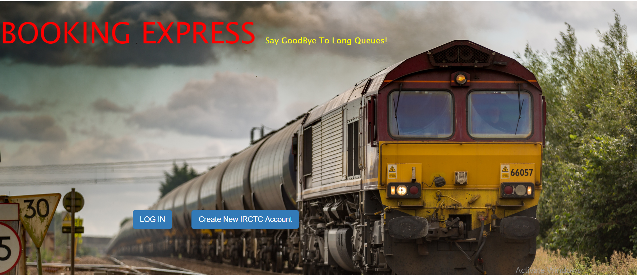
The Tree Structure of our project

Slide 9
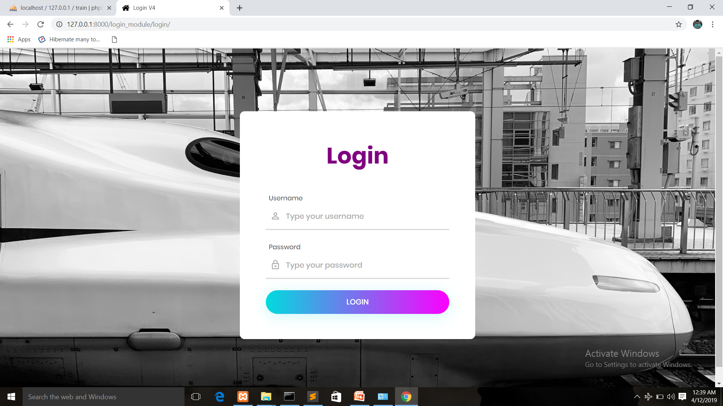
Login Page

Slide 10
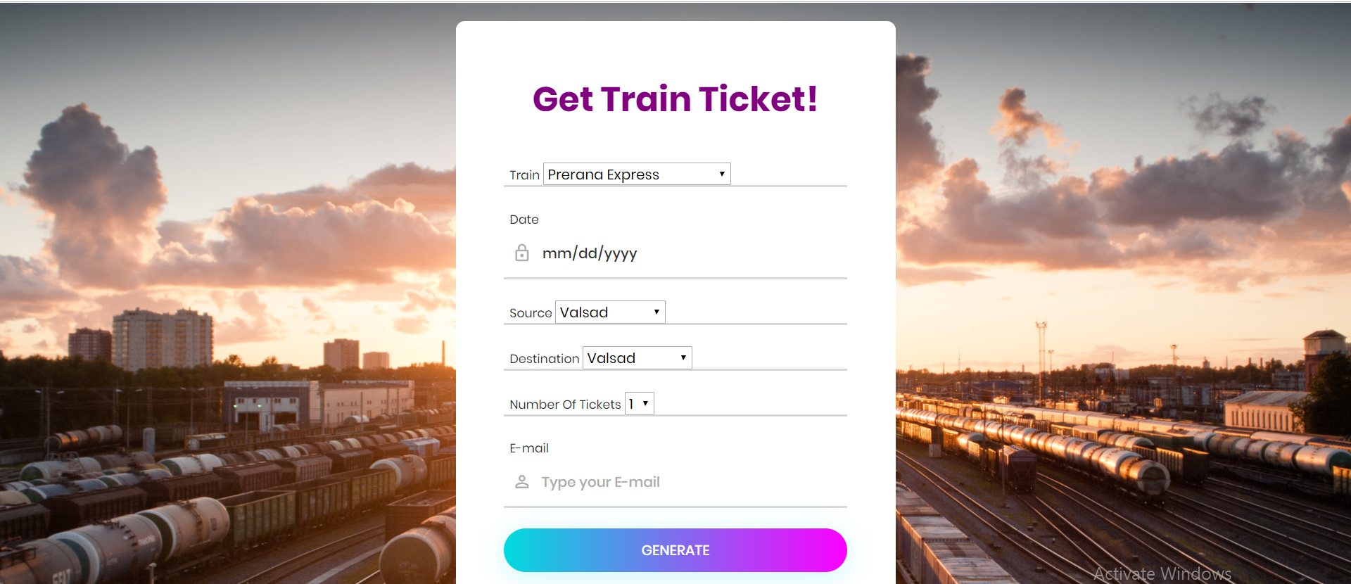
Form for Ticket Generation

Slide 11
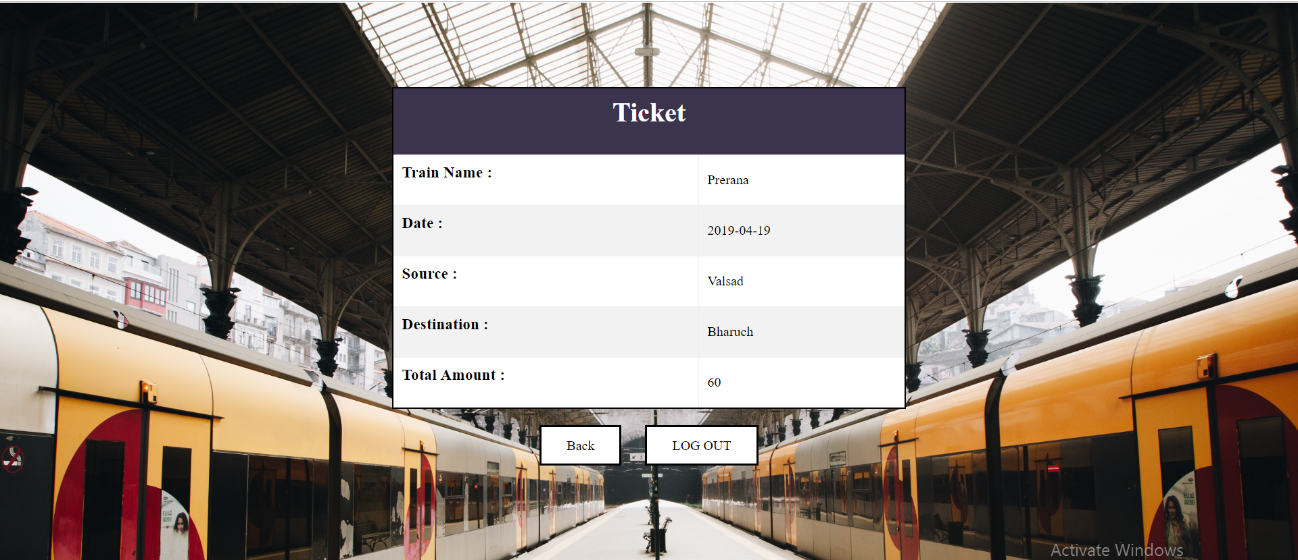
Generated Ticket Demo

Slide 12
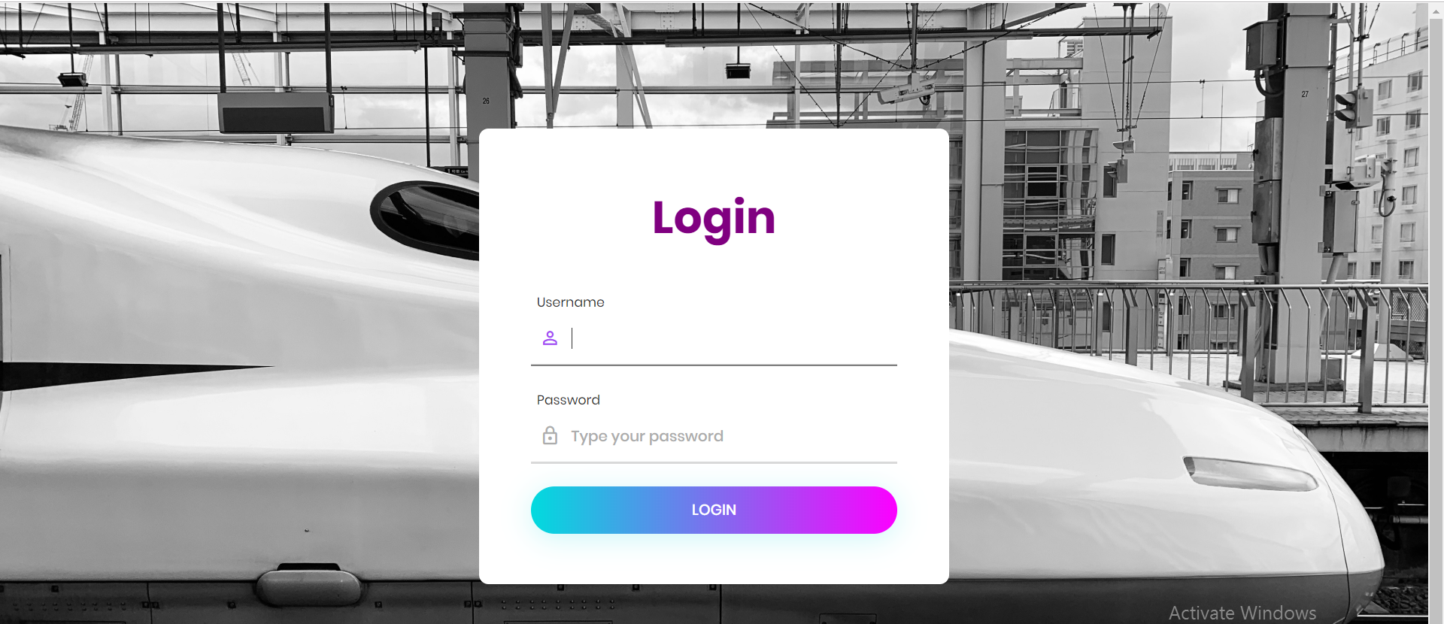
Admin Login Page

Slide 13
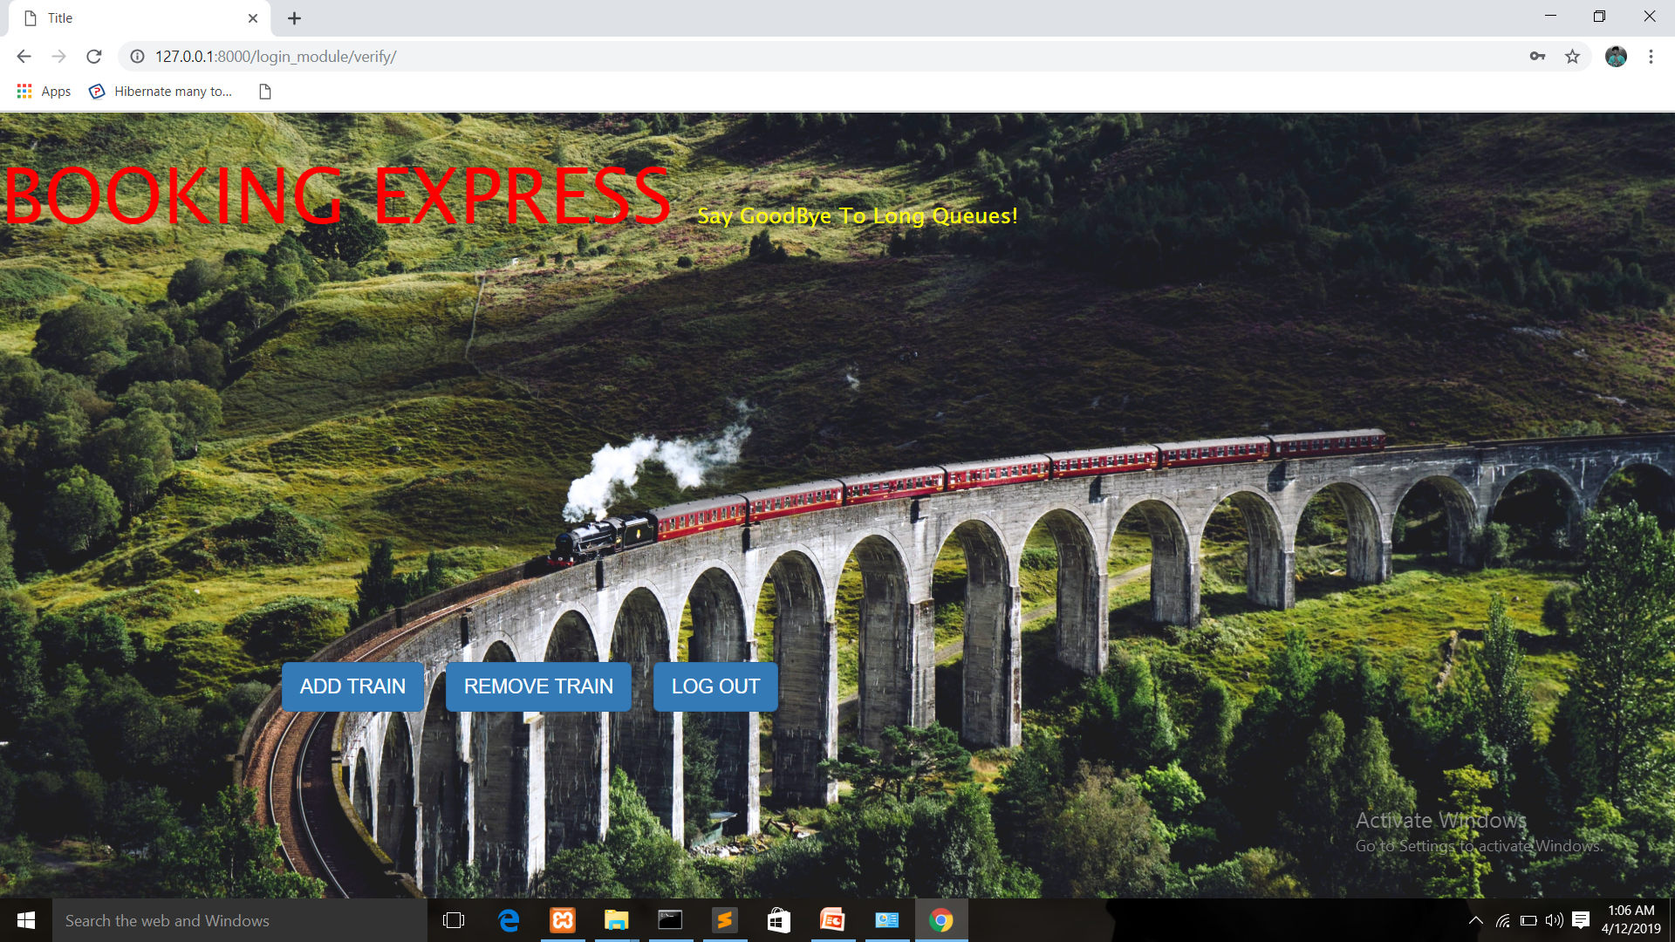
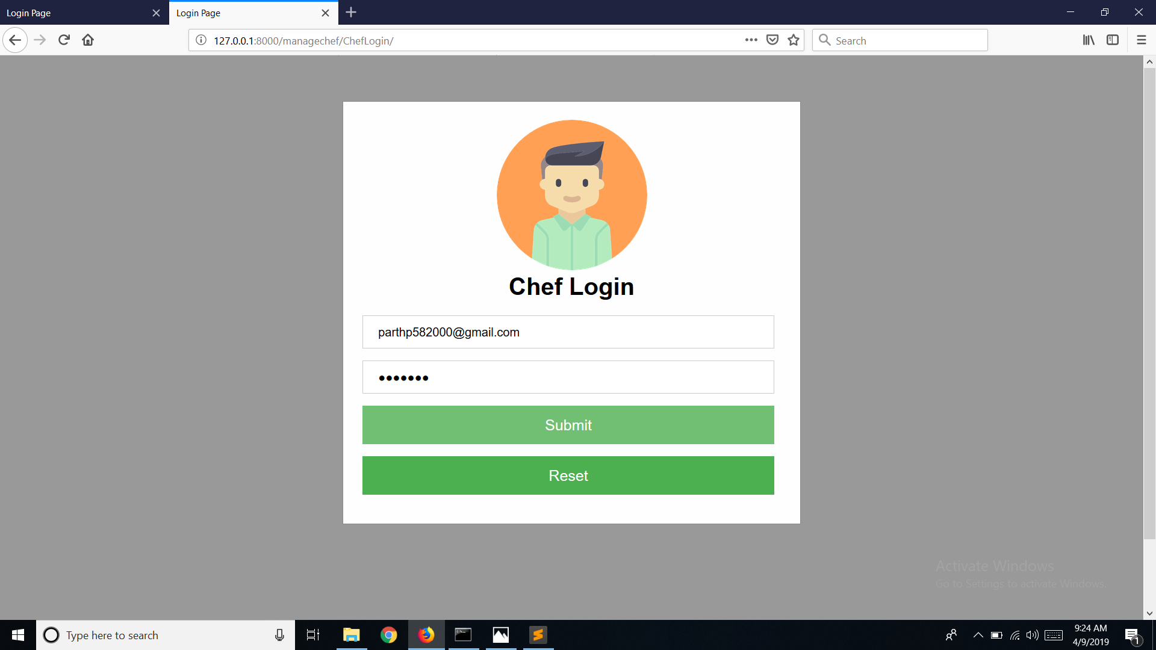
Admin Home Page

Slide 14
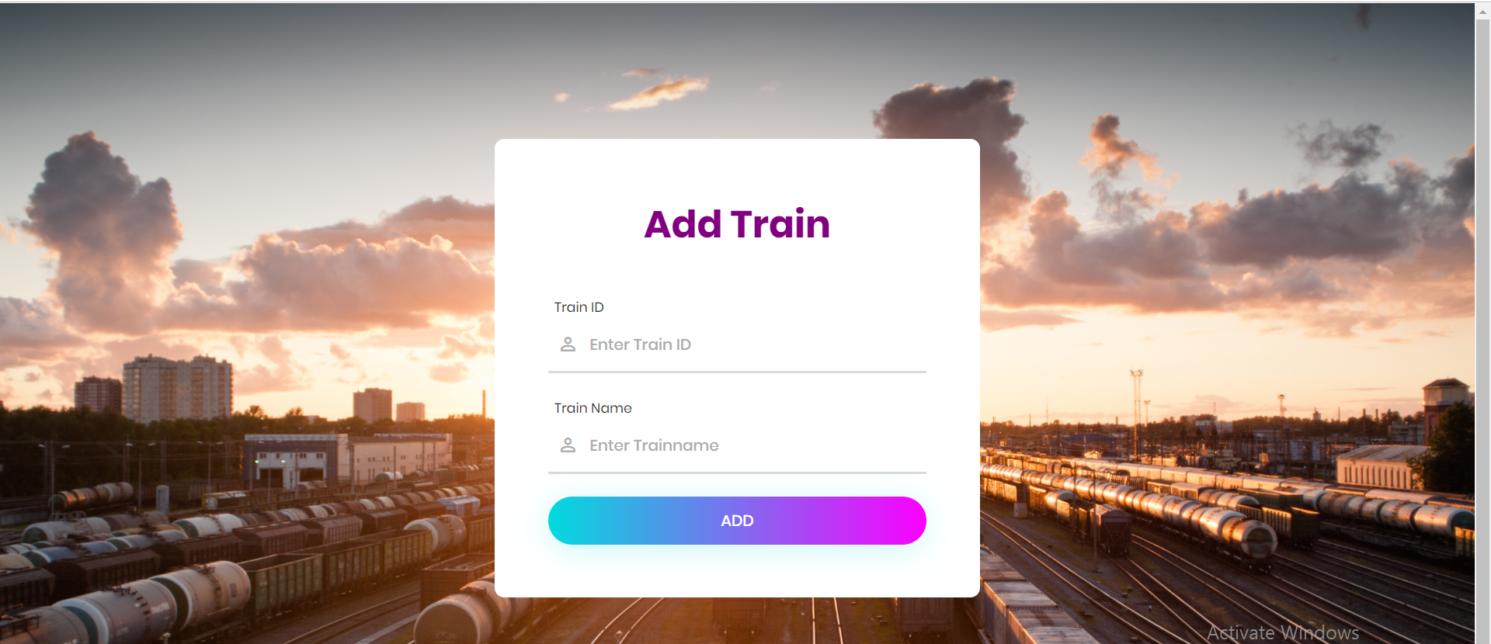
Admin add train Page

Slide 15
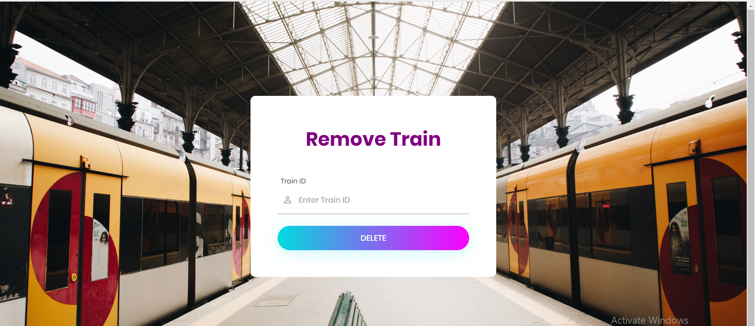
Admin Remove Train Page

Slide 16
Thank You!
Made by:
Dhruv Parmar (CE – 088)
Dhara Patel (CE – 100)
Kaushal Patel (CE – 102)

